Slide 1
APA Style
An introduction to formatting and citation
Notes:
These lecture slides are based on Scribbr’s “APA citation guidelines” article, which can be found here: https://www.scribbr.com/category/apa-style/
How to edit this presentation:
Click on ‘File’ in the top-left corner.
Click on ‘Make a copy’
Select ‘Entire presentation’
Save the presentation in your personal Google Drive.
You can now edit the copy of this presentation!

Slide 2
What is APA Style?
APA = American Psychological Association
Based on the APA Publication Manual
The 7th edition is the latest, published in 2019
Used widely, especially in the social sciences
Provides guidelines for language, formatting, and citations
Notes:
First, let’s introduce the basics: APA stands for “American Psychological Association,” the organization responsible for the APA Publication Manual.
The 7th edition of the manual was published in 2019, and is widely used as a style guide for academic writing, mainly in the social sciences.
The guide covers a variety of different topics, including language choices, punctuation, formatting, and citing sources.
This presentation first looks at the general guidelines for formatting an APA paper, and then covers the specifics of citation and referencing.
“APA Style” article: https://www.scribbr.com/category/apa-style/
“7th edition changes” article: https://www.scribbr.com/apa-style/apa-seventh-edition-changes/
“7th edition changes” video: https://www.youtube.com/watch?v=zeSIXD6y3WQ

Slide 3
APA format guidelines
Notes:
First, let’s look at how to format your paper.
Most of these rules apply to student papers, but note that there are some additional formatting guidelines if you’re preparing a manuscript for publication.
Scribbr offers free APA format templates in Word and Google Docs, with all the appropriate formatting already set up in the document.
“APA format” article: https://www.scribbr.com/apa-style/format/
APA format template in Word: https://cdn.scribbr.com/wp-content/uploads/2020/11/APA-7th-edition-template-student-version.docx
APA format template in Google Docs: https://docs.google.com/document/d/11qrDM2vYfoDsuIMLTfueB-T0UHZc7gbdMr2YzOdJ3-g/copy

Slide 4
General formatting
Times New Roman 12 pt, Calibri 11 pt, Arial 11 pt, etc.
Double line spacing
One-inch (2.54 cm) margins
Page number in the top right
Running head in the top left (if submitting for publication)
Notes:
APA Style recommends using a simple, easily readable font such as 12 pt Times New Roman or 11 pt Arial or Calibri. Don’t make any fancy font choices!
Use double line spacing in your paper.
Margins should be 1 inch (2.54 cm) wide. This is the default in Word and Google Docs, so you generally don’t have to change it.
Page numbers appear in the header at the top right of every page.
If you’re submitting the paper for publication, also include a running head with the paper’s title (shortened if necessary) in all-caps.
“Running head” article: https://www.scribbr.com/apa-style/apa-running-head/

Slide 5
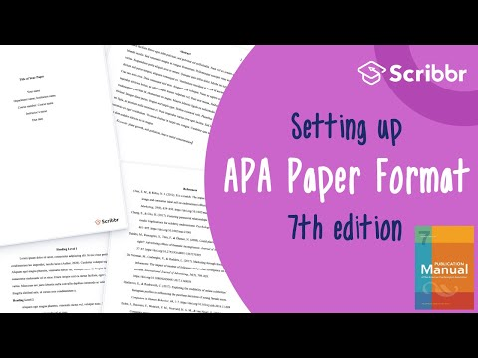
Notes:
This video goes through how to quickly get that formatting set up in your document.

Slide 6
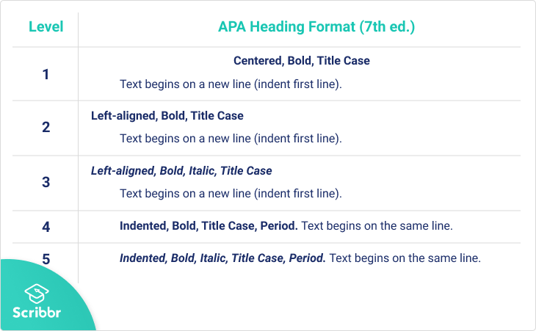
Levels of heading
Notes:
APA has specific guidelines for up to five levels of heading within your text.
A level 1 heading could be a chapter title, a level 2 heading a section within that chapter, a level 3 heading a subsection within that, and so on.
As you can see, all headings are in title case (all major words capitalized) and in bold, but different levels vary in terms of alignment, italicization, and punctuation.
In APA, headings should not be labelled with numbers or letters.
Bear in mind that you may only use one or two levels of heading within a paper, or even none; you’ll rarely need all five. It’s also fine if some sections use more heading levels than others.
“Headings and subheadings” article: https://www.scribbr.com/apa-style/apa-headings/

Slide 7
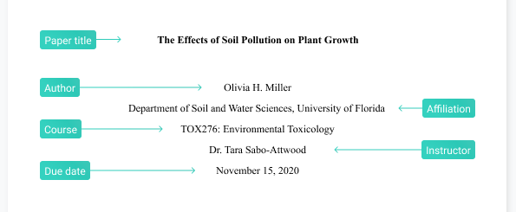
Title page
Notes:
APA also provides guidelines for creating a title page for your paper.
In a typical student paper, you should include the title, your name, your department and university, the course, your instructor, and the due date.
All this information is centered and written in the same font as the rest of the paper, about a third of the way down the title page.
The title appears in bold, other information in plain text.
The information contained on a professional title page is different—see the article below for examples and templates.
“Title page” article: https://www.scribbr.com/apa-style/apa-title-page/

Slide 8
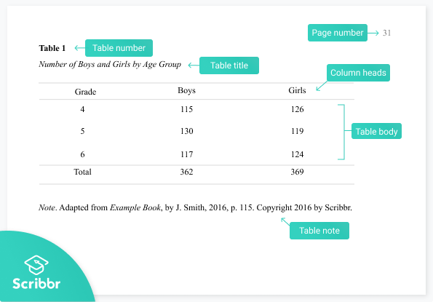
Tables and figures
Notes:
Finally, APA has a standard format for presenting any tables and figures in your paper.
Give each table and figure a number, in the order they appear in the paper. Tables and figures are numbered separately.
Include the table or figure number and title above the image, and include any necessary explanatory notes below.
Tables and figures can be placed throughout the text wherever each one is first referred to, or they can be collected at the end, after the reference list.
“Tables and figures” article: https://www.scribbr.com/apa-style/tables-and-figures/

Slide 9
In-text citations
Notes:
Now for the part students often find tricky: citations and references.
Properly citing your sources is essential to avoid accusations of plagiarism in your work, and APA provides detailed guidelines for doing so.
Audience question: Do you know what’s included in a standard in-text citation in APA Style?

Slide 10
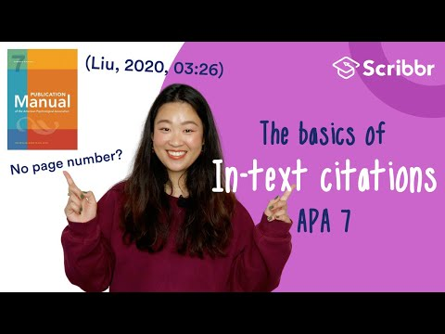
Notes:
The standard features of an in-text citation are the author’s last name and the year of publication—they’re sometimes referred to as “author–date citations.”
They also feature a page number when you’re citing a specific part of a text.
This video explains the basic format.
“In-text citation” article: https://www.scribbr.com/apa-style/in-text-citation/

Slide 11
Basic in-text citation format
Parenthetical citation
It is important to avoid plagiarism in academic writing (Smith, 2020, p. 15).
Narrative citation
Smith (2020, p. 15) states that it is important to avoid plagiarism in academic writing.
Notes:
Let’s take a closer look at those two forms of in-text citation.
Parenthetical citations enclose the whole citation within parentheses, while narrative citations treat the author’s name as part of your sentence.
Both are equally valid choices; you might want to use narrative citations when it’s important to emphasize whose research you’re engaging with, and parenthetical citations when you’re citing a variety of sources in quick succession.
Note the punctuation: Commas separate the different elements within the parentheses, and the period comes after the citation at the end of a sentence.

Slide 12
Multiple authors
 | Parenthetical citation | Narrative citation
1 author | (Smith, 2020) | Smith (2020)
2 authors | (Smith & Jones, 2020) | Smith and Jones (2020)
3+ authors | (Smith et al., 2020) | Smith et al. (2020)
Notes:
What about when a source has more than one author? It depends how many there are.
When a source has two authors, list both, separated by an ampersand in a parenthetical citation or the word “and” in a narrative citation.
When a source has three or more authors, only the first author is named, followed by the term “et al.” This is Latin for “and others.”

Slide 13
Missing information
No author | (Scribbr, 2020) (“Statistical analysis,” 2020)
No date | (Smith, n.d.)
No page numbers | (Smith, 2020, para. 10)
Notes:
In many cases, especially with online sources, certain information usually included in an in-text citation might be missing. APA provides guidelines for working around this.
When no author is listed for a source, the usual solution is to list the organization responsible as the author.
If that’s not possible, you can use the title of the source in the citation instead.
When the publication year is unclear or the source is continually updated, you can replace the year with “n.d.” (no date).
When page numbers are unavailable (for example, on a webpage), you can use whatever locators are available, such as paragraph numbers, section headings, or timestamps in a video.

Slide 14
Combining citations
(Smith, 2020) (Jones, 2015) (McCombes et al., 2017)
(Jones, 2015; McCombes et al., 2017; Smith, 2020)
Notes:
Finally, if you want to cite several sources in one place—for example, if a specific finding has been replicated by various studies—you can combine them in a single parenthesis.
Use semicolons to separate the sources, and list them in alphabetical order.

Slide 15
The reference list
Notes:
If it seems like in-text citations don’t give very much information, that’s because full source information is saved for the reference list.
If a reader wants to consult one of your sources, they can use the in-text citation to look up details of the source in your reference list.

Slide 16
Reference or no reference?
Page on a website
Interview you conducted
Article from an academic journal
Email from an expert
Book used as background reading
Chapter from a book that you cited
PowerPoint slides from a lecture
Facebook status
Notes:
Audience question: Look at the sources listed here. Which of them do you think would be included in your reference list, and which ones wouldn’t be?

Slide 17
Reference required | No reference required | It depends…
Page on a website | Interview you conducted | Facebook status
Book | Email | Lecture slides
Article from an academic journal | Background reading
Notes:
Your reference list includes all sources you cited in your paper and which your reader can access for themselves.
So in our case, a web page, book, or journal article are all sources the reader will be able to consult themselves after seeing them in your references.
However, some of the information you include won’t be something the reader can look up.
An email you received is only accessible to you, and an interview you conducted can’t be referenced unless it was already published elsewhere.
Background reading you didn’t cite in the paper isn’t included in the reference list: you only include sources you actually referred to in the text.
A Facebook status or lecture slides may or may not be accessible to your reader. For example, a status from a public page would be referenced, but one from a private profile would not.
And lecture slides publicly available online can be referenced, while those you only saw in class cannot.

Slide 18
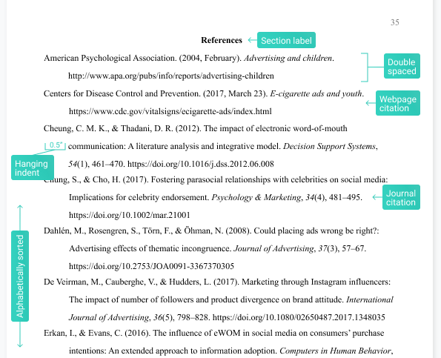
Format of the reference page
Notes:
The reference page appears at the end of the paper,after the main text but before any appendices.
You can see an example of a reference page in this image. The heading “References” appears at the top, centered and in bold.
Each entry has what’s called a “hanging indent,” which means that the second and subsequent lines are indented. This allows the reader to easily see where a new entry begins.
Entries are alphabetized by authors’ last names, which appear at the start of each entry.
The specific format of a reference list entry varies by source type, but there are a few elements that are always included.
Audience question: What do you think are the four basic components of a reference entry—the standard pieces of information included for all sources?
“Format of reference page” article: https://www.scribbr.com/apa-style/apa-reference-page/
“Alphabetization” article: https://www.scribbr.com/apa-style/ordering-references/
“Formatting the APA reference page” video: https://www.youtube.com/watch?v=JmVZP2309P4&ab_channel=Scribbr

Slide 19
Components of a reference entry
Author
Date
Title
Source
Notes:
The four components of a reference entry are the author, publication date, title, and source—listed in that order.
The precise information included differs depending on the source type (e.g. book vs. journal article), but these basic components are always included when available.
Let’s go through each of the components in turn.
“Reference entry” article: https://www.scribbr.com/apa-style/reference-entry/

Slide 20
The author component
One author | Anderson, B.
Multiple authors | Andreff, W., Staudohar, P. D., & LaBrode, M.
Corporate author | Scribbr.
With username | Obama, B. [@BarackObama].
With specific role | Scott, R. (Director).
Notes:
The author element of a reference is listed with the surname first, followed by the initials and ending with a period.
When a source has multiple authors, up to 20 are listed in the reference, so in most cases you’ll list all of them.
Some sources don’t list a specific individual author; in this case, you can usually list a corporate author, i.e. the name of the organization responsible for the source.
Users on social media sites often have usernames in addition to their real names; these can be listed in square brackets.
Finally, in certain types of citation the author component might list someone in a different role, like the director for a film. This can be specified in parentheses.

Slide 21
The date component
Year only (books and journals) | (2020).
Full date (web pages, newspapers, online videos) | (2020, November 20).
No publication date available | (n.d.).
Retrieval date for online sources that are continually updated | Retrieved December 3, 2020, from …
Notes:
The date component always appears in parentheses, followed by a period.
The level of detail varies depending on the source type. For most source types, you’ll just list the year.
For sources like newspapers or blogs that are more frequently published, the full date is included in your reference.
When the publication date is unknown, replace this component with the abbreviation “n.d.”, standing for “no date.”
For online resources that are designed to be continually updated, you’ll use “n.d.” and add a retrieval date indicating the exact day when you accessed the source. This appears after the title in your reference.

Slide 22
The title component
Italics for standalone sources (books, films) | Statistical methods for psychology.
Plain text for sources within sources (articles, chapters, web pages) | The evolving European model of sports finance.
Square brackets to describe untitled sources | [Photograph of a wren].
Notes:
Titles in APA Style are written in sentence case (meaning only the first word and any proper nouns are capitalized). They end with a period.
The titles of sources that stand on their own, like a book or movie, are written in italics.
The title of a source contained within a larger work, like an article in a journal or an essay in a collection, is written without italics.
In the case that a source you use doesn’t have a title, you can write a short description of it in square brackets in the title position.

Slide 23
The source component
Book publisher | Verso.
Journal issue | Journal of Sports Economics, 1(3), 257–276. https://doi.org./10.1177/152700250000100304
Website | BBC News. https://www.bbc.com/news/health-54531075
Physical location | Museo del Prado, Madrid, Spain.
Notes:
The source component specifies where the source can be found. This part varies a lot depending on what you’re citing.
You might list the source’s publisher, the website where it was found, its physical location, its page range within a larger work …
Only some of this information will apply in each case; for example, for a journal article (the final example here) you’ll include the name of the journal in italics, the volume and issue number, the page range of the article, and a DOI if available.
A DOI is a digital object identifier; it’s a very stable link to an online resource, often available for academic publications, which you should use if available.

Slide 24
The full reference entry
Anderson, B. (1983). Imagined communities: Reflections on the origins and
spread of nationalism. Verso.
Andreff, W., & Staudohar, P. D. (2000). The evolving European model of
professional sports finance. Journal of Sports Economics, 1(3),
257–276. https://doi.org./10.1177/152700250000100304
Rowlatt, J. (2020, October 19). Could cold water hold a clue to a
dementia cure? BBC News. https://www.bbc.com/news/health-54531075
Notes:
These are some examples of reference entries with the four elements highlighted: author in green, date in blue, title in yellow, and source in orange.
The examples shown are a book, journal article, and web page respectively.
As you can see, the source element in particular can vary in terms of complexity, but there’s a recognizable common structure to all types of reference.
It can still be tricky to know what to include in each case, but Scribbr offers clear formats and examples for all citing all kinds of source in APA Style.
Book citation article: https://www.scribbr.com/apa-examples/apa-book-citation/
Journal citation article: https://www.scribbr.com/apa-examples/apa-journal-citation/
Website citation article: https://www.scribbr.com/apa-examples/cite-a-website/

Slide 25
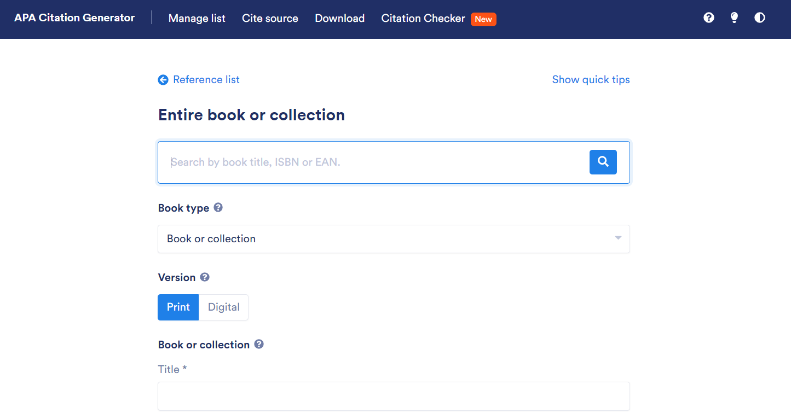
Scribbr citation generator
Notes:
Scribbr also offers a free citation generator, allowing you to create in-text citations and compile your reference list easily.
You can search for a source by title, DOI or ISBN to have its details filled in automatically, or you can fill in the fields manually.
Your reference list is saved and alphabetized, and you can keep updating it until you’re done with your paper.
Then simply download your reference list, and copy properly formatted in-text citations for each reference to insert into your text wherever they’re needed.
Link to the citation generator: https://www.scribbr.com/apa-citation-generator/

Slide 26
Recommended resources

Slide 27
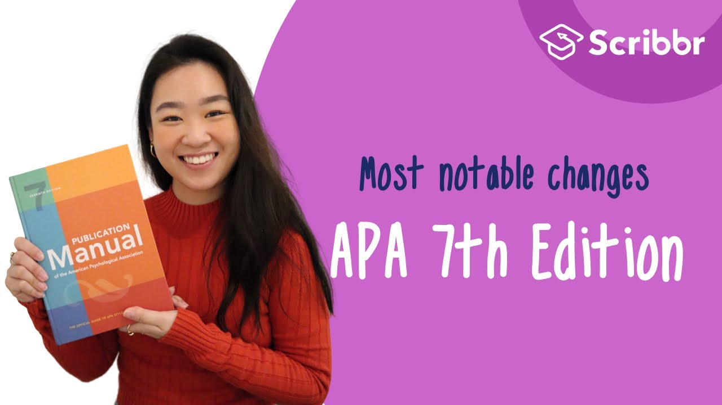
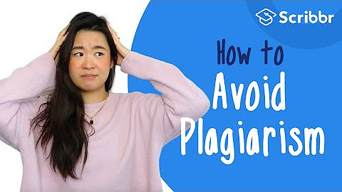
Free Scribbr resources
Other resources
Knowledge Base (300+ articles)
Citation Generator
YouTube Channel
Buy the APA Manual
Check out the APA Style Blog
Notes:
Scribbr provides high-quality articles and videos for free. Every month over 2 million students make use of these resources.

Slide 28
Hi, we’re Scribbr 👋
We are a team of 60 people in Amsterdam, and we partner with more than 500 freelance editors across the globe to help students graduate and become better academic writers.
Every day, we work hard on our Proofreading & Editing service, Plagiarism Checker, Citation Generator, Knowledge Base and educational YouTube channel.

Slide 29
Guidelines for using this presentation
This presentation can be freely used and modified for educational purposes. You may:
Display this presentation in a classroom environment
Modify or delete slides
Distribute this presentation in print or in private student environments (e.g. Moodle, BlackBoard, Google Classroom)
Please do give credit to Scribbr for creating this resource.
Questions or feedback? Email shona@scribbr.com and we’ll be in touch!
Notes:
How to edit this presentation:
Click on ‘File’ in the top-left corner.
Click on ‘Make a copy’
Select ‘Entire presentation’
Save the presentation in your personal Google Drive.
You can now edit the copy of this presentation!

